Slide 1

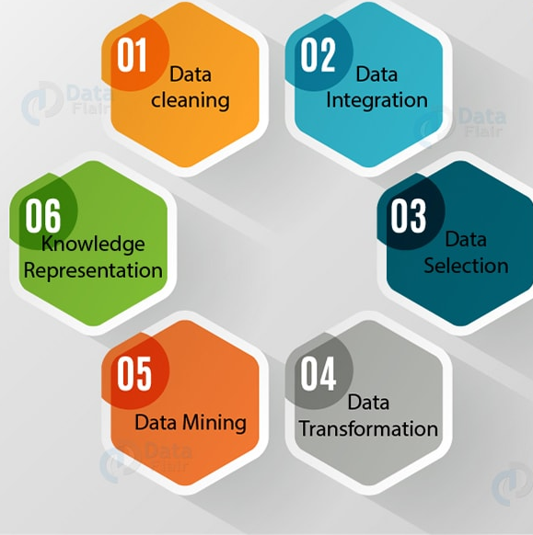
Data Science in Practice: Explainable AI & a few case studies
Tahmina Zebin
University of East Anglia, Norwich, UK
EMAIL: t.zebin@uea.ac.uk
WEBSITE: https://people.uea.ac.uk/t_zebin

Slide 2

Session Outline
Who am I and What I Do?
Model Interpretation: Explaining what an Artificially Intelligent model is learning from the data.
Demo..
Brief description of case studies in
Customer-Relationship Management
Financial
Retail
Use Cases in bioinformatics and environmental science
Summary
Notes:
SHAP: SHapley Additive exPlanations
LIME: Local Interpretable Model-Agnostic Explanations

Slide 3
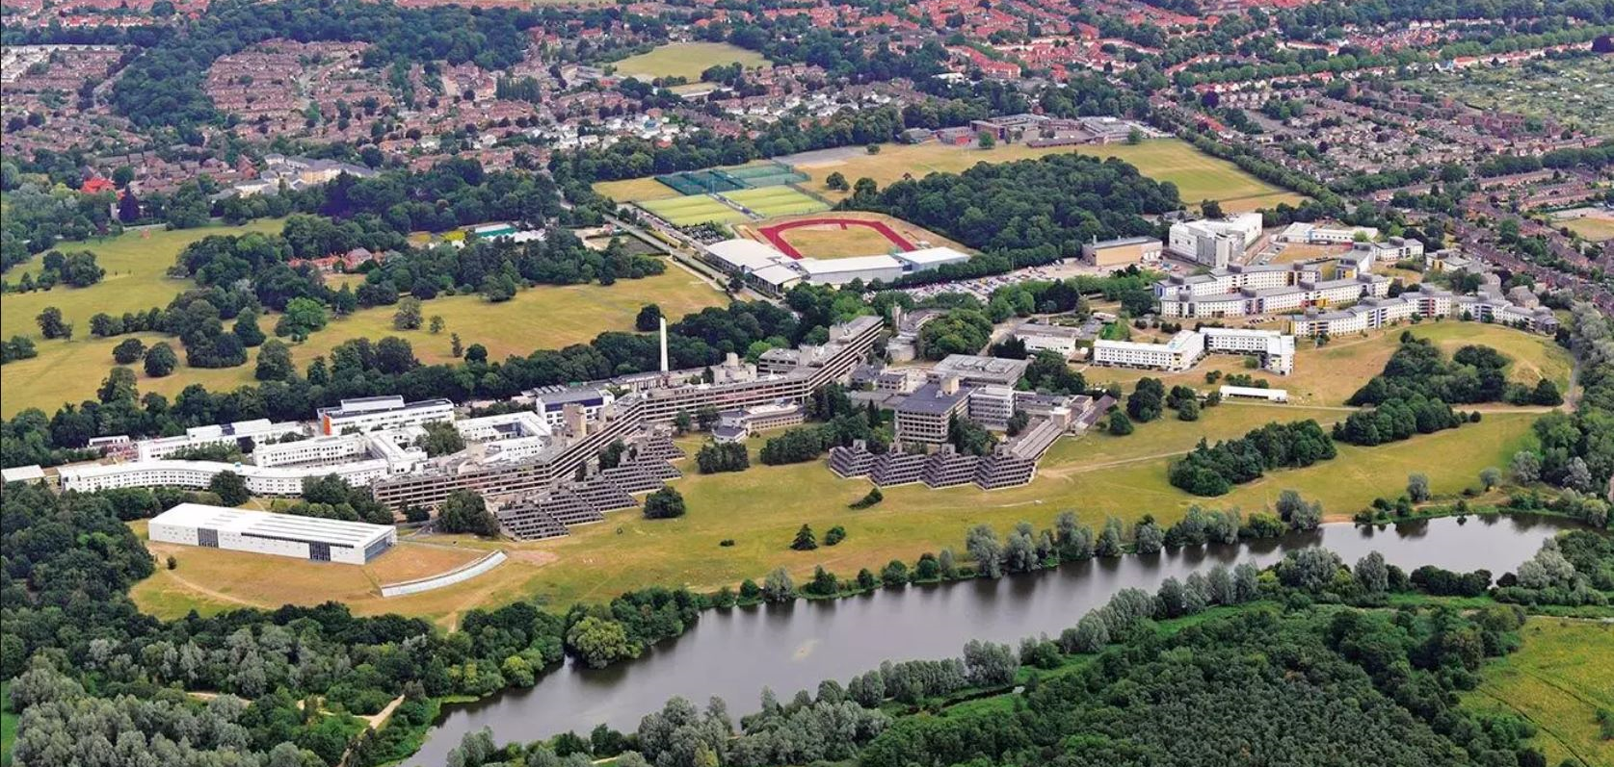
My Introduction..
Electrical and Electronic Engineer by Training.
First degree from University of Dhaka, Bangladesh
MSc and PhD in Electrical and Electronic Engineering from University of Manchester, UK
Am a Lecturer at the University of East Anglia, in Norwich, UK
University of East Anglia

Slide 4
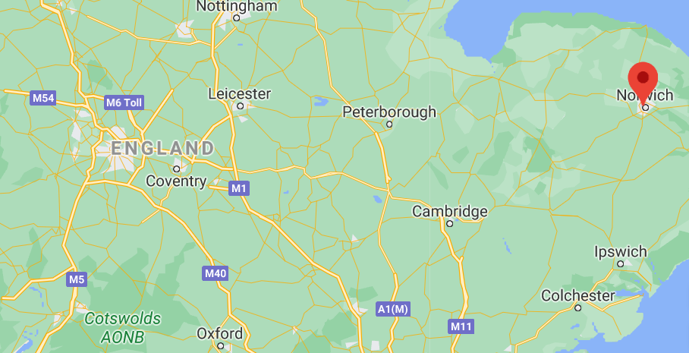
Where I am based..
Norwich, UK
University of East Anglia

Slide 5
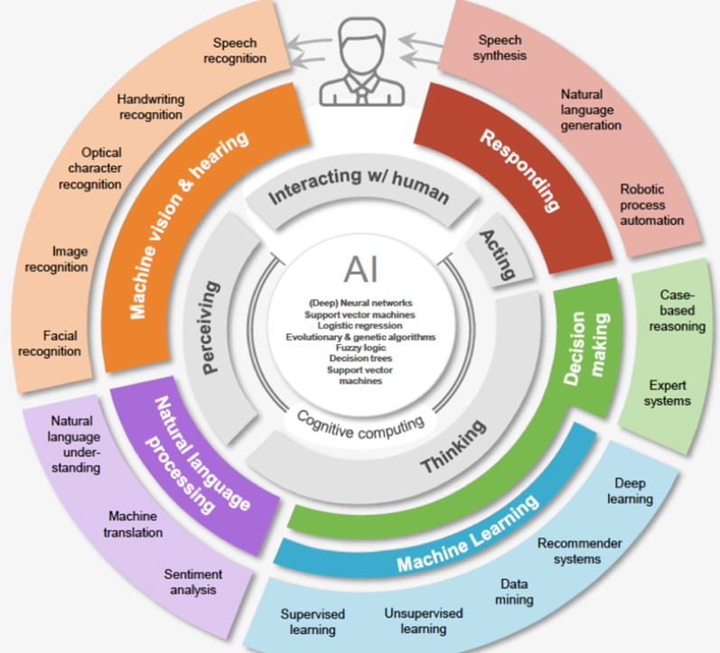
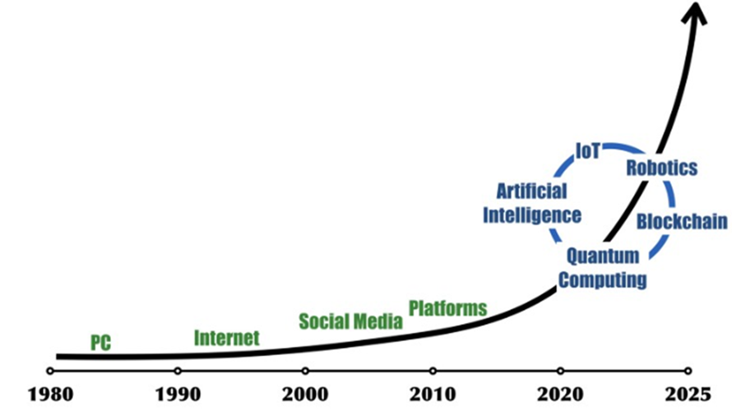
An Era of AI
I mainly do Explainable AI for the healthcare sector in the UK as part of my research and consultancy
I use Data Science, Machine Learning and AI for teaching and research.
Source: Boston Consulting Group
Notes:
Boston Consulting Group

Slide 6
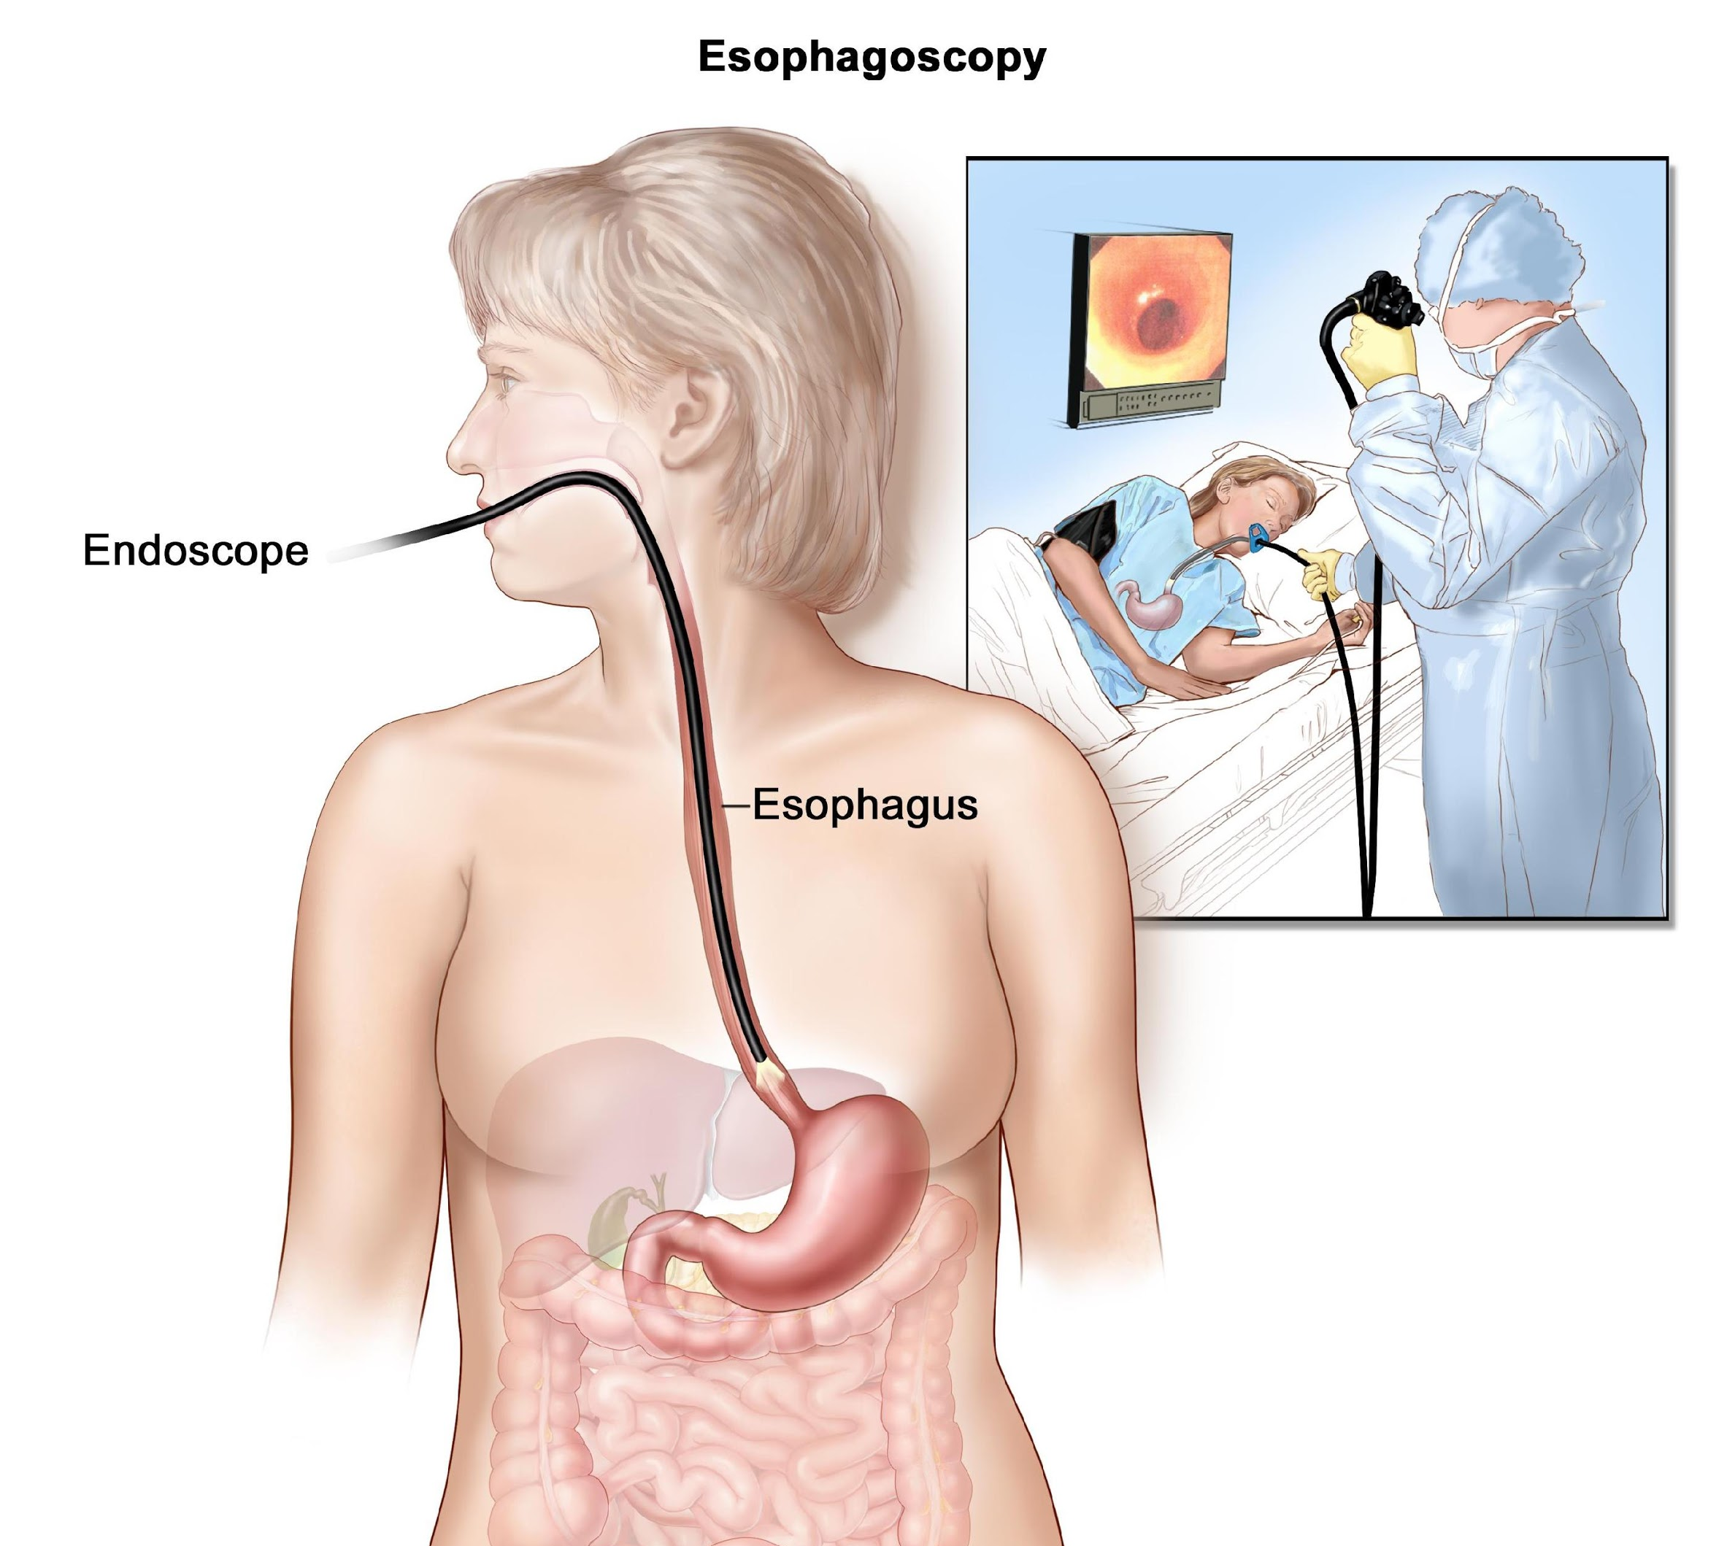
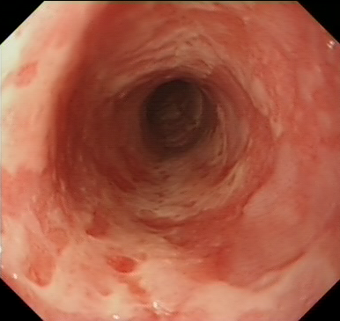
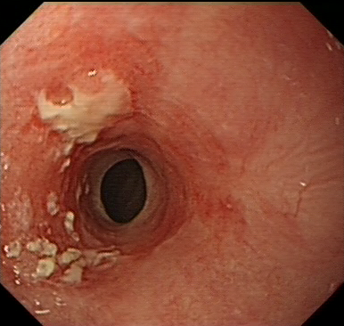
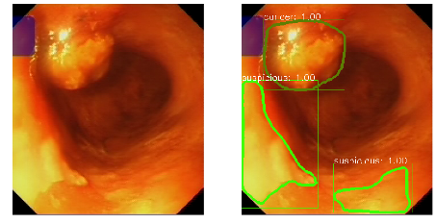

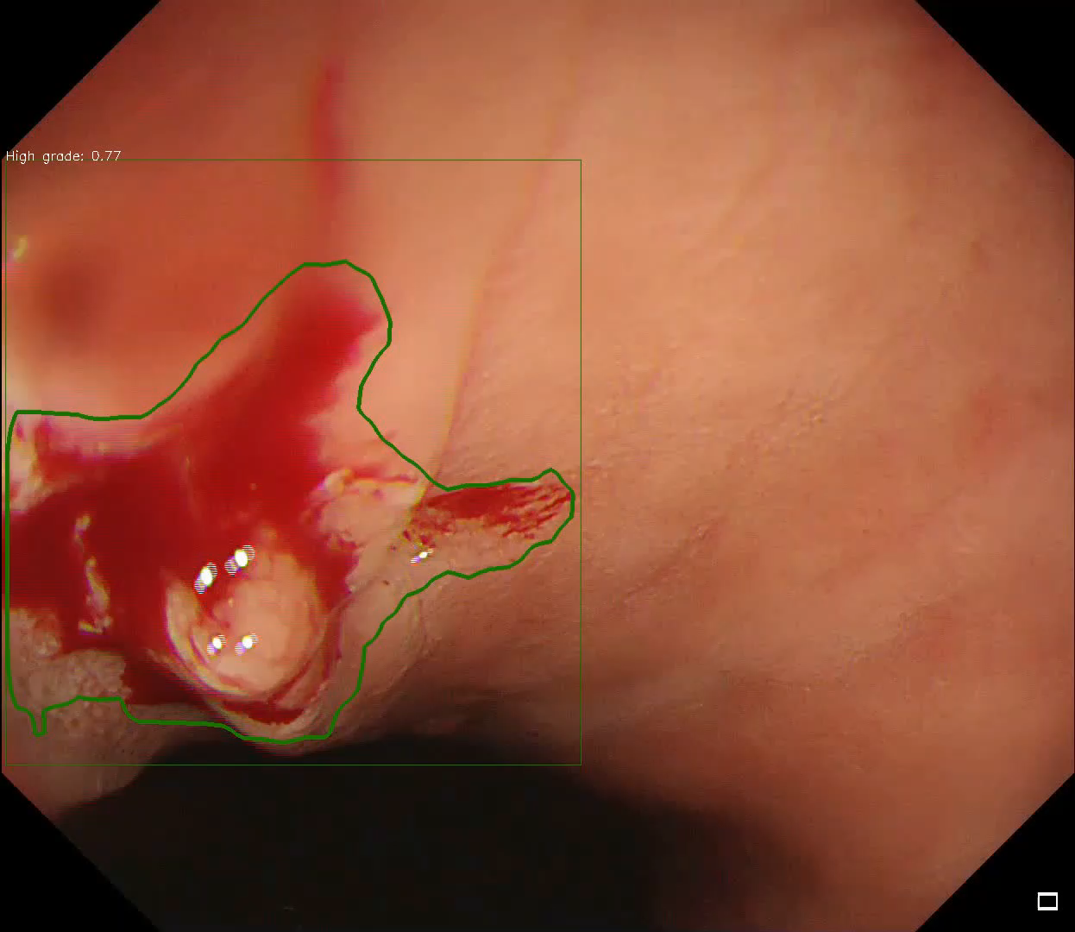
Early Detection of Oesophageal Cancer from Endoscopic Videos
Suspicious/Low grade
High
grade
cancer
Endoscopic video analysis : for early detection of Oesophageal Cancer
Pilot Study : 27 Subject Dataset, Algorithm applied: Mask RCNN, YOLOv3, maskrcnn-benchmark, Augmentation required to reduce false prediction (Average precision @ IOU:.75, 82.1%)
Dataset obtained from Prof. Barbara Braden, Oxford University Hospitals, UK
Notes:
Based on the information I got from the advertisement, there is description of analyzing complex free-swimming videos, The first relevant experience on video analyzing I have is on endoscopic videos of Oesophagus. Our aim was to detect and segment the cancerous regions. Hence, I am going to talk in brief about the technical approach we have taken for Oesophageal Cancer detection. This was a Cancer research UK funded.
You may know, Esophegus is a part of the digestive system and esophegal cancer is monitored by capturing endoscopic video by passing the camera through the gastro-intestinal tract. The data source we used was endoscopic video. Some frames from the video are labelled by an expert physician in three different region such as suspicious, high grade and cancer.
When there is some inflammation in oesophagus regions are labelled as Suspicious. You can see in this image. When the inflammation is severe then that is labelled as high grade. When it takes a form of tumour it is labelled as cancer.
In our labelled dataset, which has 27 participate where we have 108 instances labelled as cancer, there are 181 for high grade and 905 instances for suspicious region.
Things to notice in dataset- Highly imbalanced,-Data-set is very small,-Balanced Augmentation is necessary

Slide 7
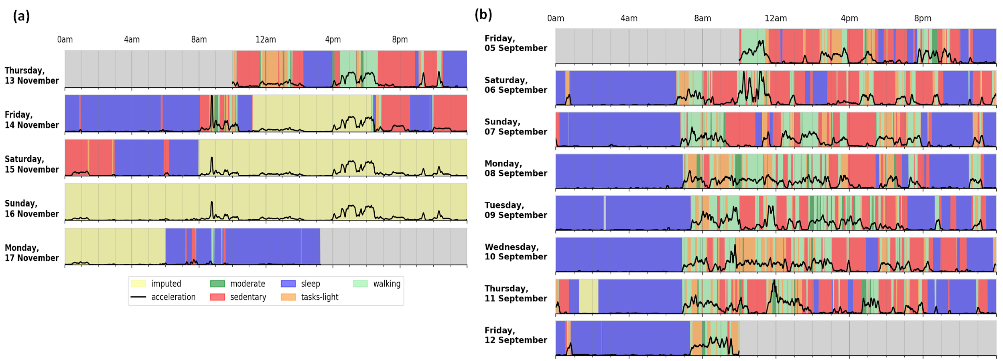
Wearable clinic (University of Manchester)
Sedentary and active behaviour analysis in subjects with Serious Mental illness.
Sensor data classification and visualization pipeline.
https://people.uea.ac.uk/files/161670132/Accepted_Manuscript.pdf
Notes:
Adaptation of a Convolutional neural network for raw human activity data analysis (using 1-D convolution).
Codes and data available at:
https://github.com/TZebin
Presented in IEEE sensors, EIT HealthWare and EMBC conferences.
Extended two conference papers to a Book chapter and as a journal paper in IJNS.
‹#›

Slide 8
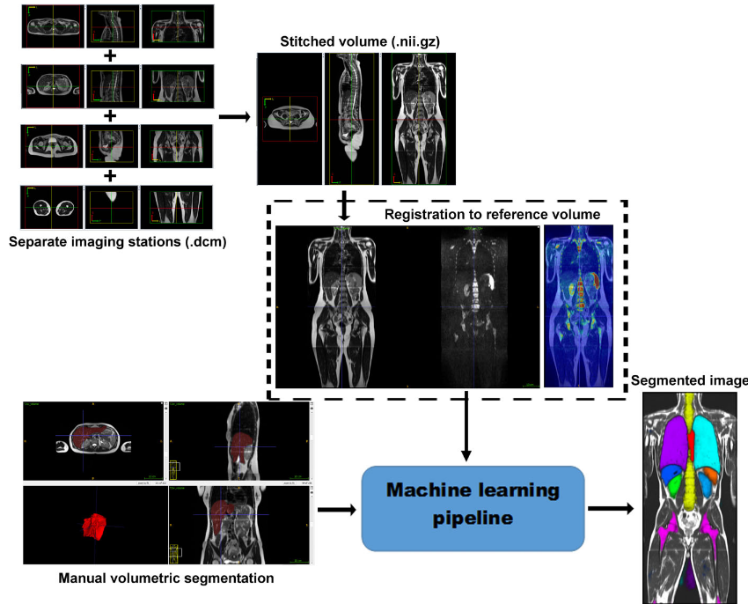
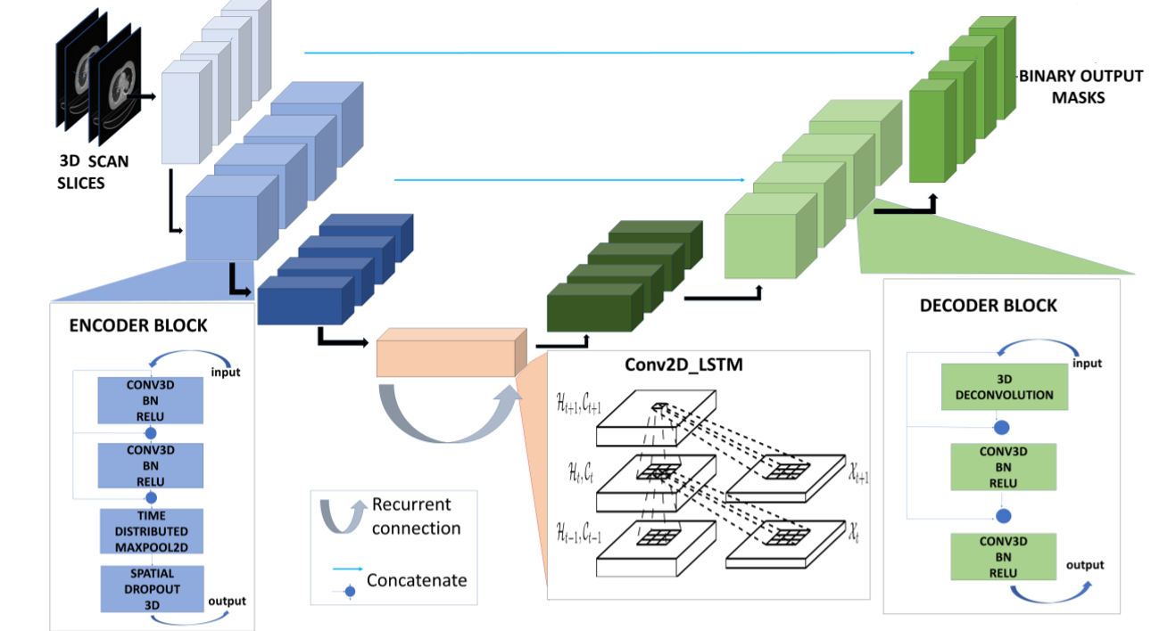
Organ segmentation and landmark/key point Detection for Body MRI Scans (3-D Algorithms)
Algorithm applied: 3-D U-net
Initial Organ Segmentation: Liver (fatty-liver)
Dataset: UK Biobank

Slide 9

Model Interpretation: Explaining what an Artificially Intelligent model is learning from the data.
Notes:
Lets begin

Slide 10
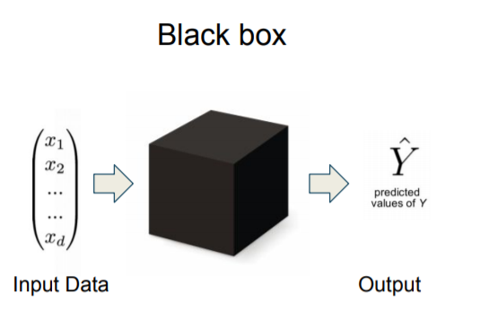
Explainable AI (XAI)
Explainable AI (XAI) refers to methods and techniques in the application of artificial intelligence technology (AI) such that the results of the solution can be understood by humans.
Explainable AI (XAI) inspects and tries to understand the steps and models involved in making decisions.
It contrasts with the concept of the "black box" in machine learning where even their designers cannot explain why the AI arrived at a specific decision.

Slide 11
Why is it important?
Commercial Drive: Many enterprises rely on machine learning models to make important decision
Loan, credit card application
To buy / sell commodities, stocks or advertisements
Diagnose cancer or benign cells
Technical Drive: Can you trust your model based on accuracy?
Understand edge cases and circumstances of failure
Knowing the ‘why’ can help you learn more about the problem and the data
Improve the model
Social and ethical aspect: Machine learning models pick up biases and may really harm vulnerable group of people
Be cautious about marketing strategy
Fairness: e.g., automatic approval or rejection of loan applications
Trust:
It is easier for humans to trust a business that explains its decisions
Legal Regulation:
GDPR: the customer has right to obtain explanation

Slide 12
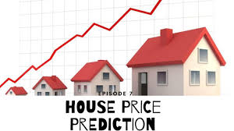
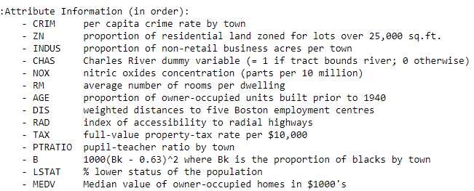
A Simple model for House Pricing regression
Predicting the selling price of a given house in the Boston (MA) area.
As an application of this model in the real world, you can think about being a real state agent looking for a tool to help you on your day-to-day duties.

Slide 13
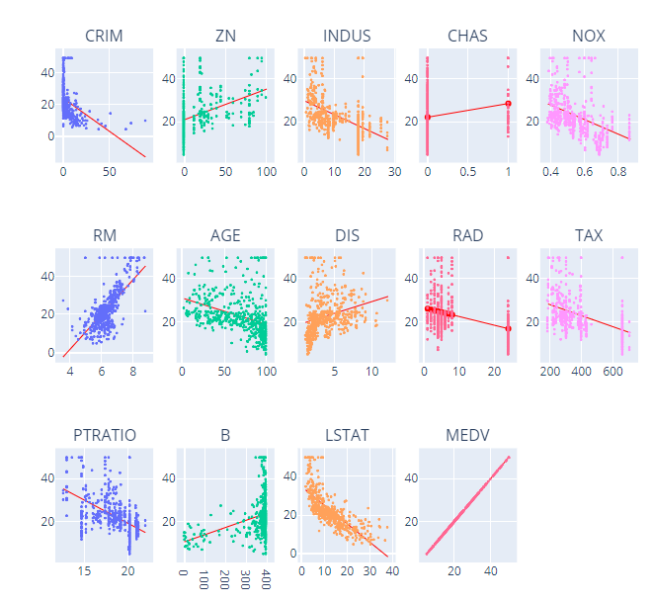
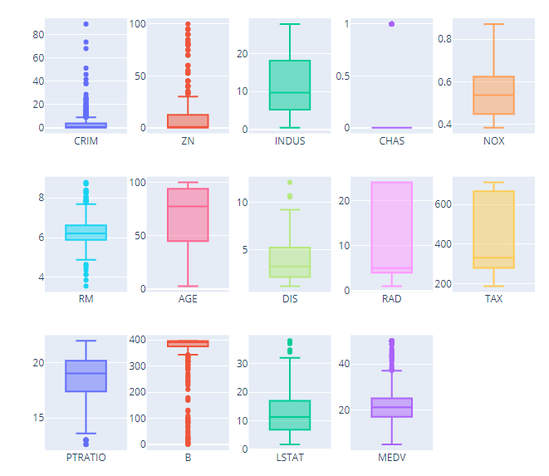
Exploratory Data Analysis
Box Plot
Scatter Plot with polynomial fitted line
Notes:
From this initial data exploration, we can have two major conclusions:
There is a strong linear correlation between the RM (average number of rooms per dwelling) and LSTAT (% lower status of the population) with the target variable, being the RM a positive and the LSTAT a negative correlation.
There are some records containing outliers, which we could preprocess in order to input our model with more normalized data.

Slide 14
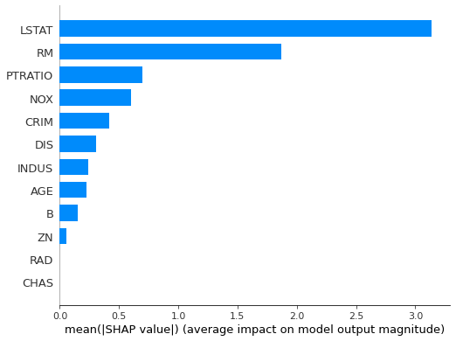
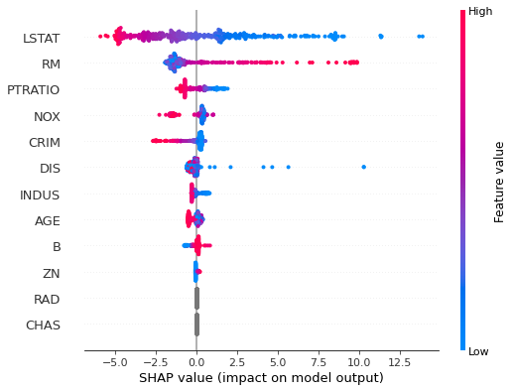
Feature importance and Summary Plot
https://github.com/slundberg/shap

Slide 15
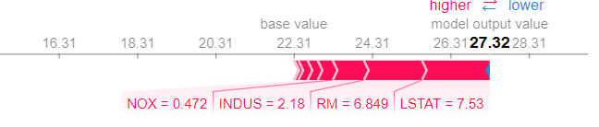
Additional plots
Force Plots and dependence plots
Decision Plots
https://slundberg.github.io/shap/notebooks/plots/decision_plot.html

Slide 16
Demo time..
Jupyter Notebook..

Slide 17
“ Interpretability is the degree to which a human can understand the cause of a decision.”
-- Miller, Tim. “Explanation in artificial intelligence: Insights from the social sciences.”
Ada Lovelace Datathon 2021
https://www.facebook.com/events/991656231357176/
Bangladesh Open Source Network - BdOSN and Her WILL

Slide 18
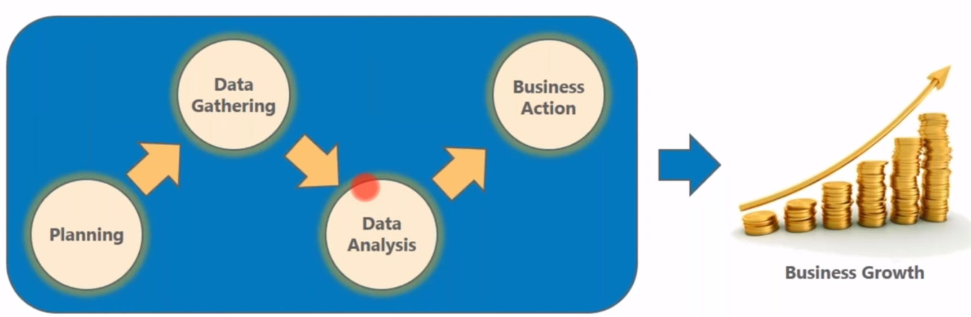
Business Intelligence, Data Mining and Data warehousing
Business Intelligence is an activity which contributes to the growth of any company.
Data Mining is the process of analyzing the data in different dimensions and Summarizing it into useful info.
Data is searched, retrieved and analyzed from a data warehouse (other storage mechanism) to answer business questions.
Data Warehousing is about storing analytical data in a structure suitable for data mining.

Slide 19
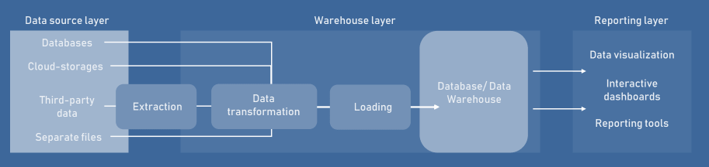
Data at different Stages before reporting

Slide 20
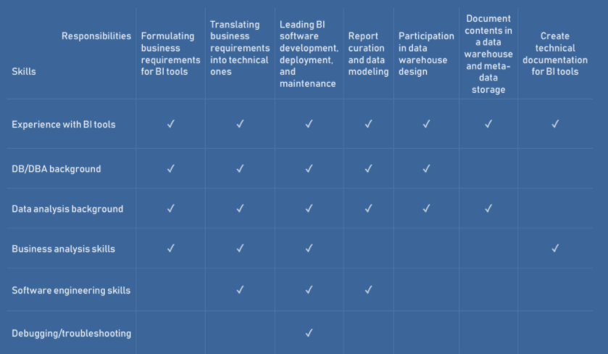
Skills that you can gain for yourselves….

Slide 21
Some Use Cases

Slide 22
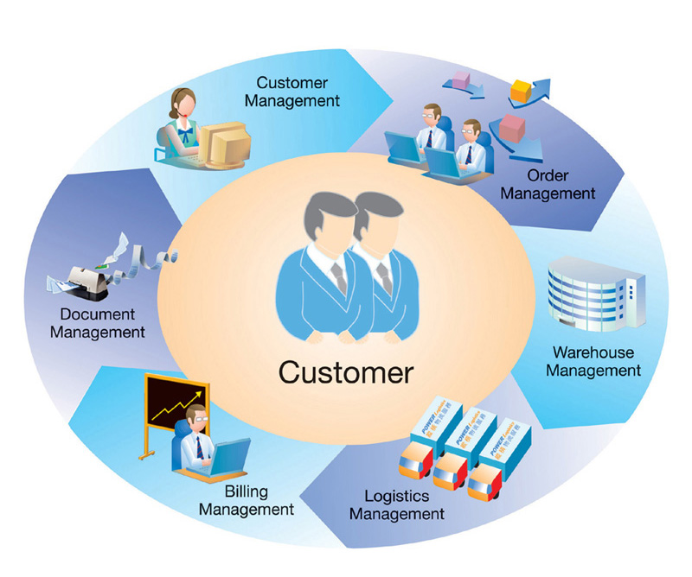
Customer Relationship Management (CRM)

Slide 23

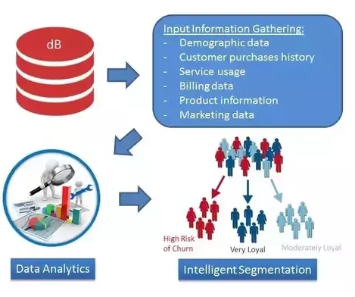
CRM-I : Customer Retention
Customer retention is the process of analyzing and predicting customer behavior.
Probably the most widely used application in data mining.
Companies can study customers and try to predict if they will churn in the future. For customers likely to churn the company may offer discounts and promotions.
Retention Offer
Campaign Optimization

Slide 24
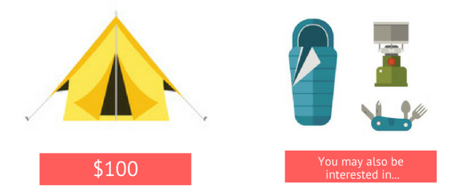
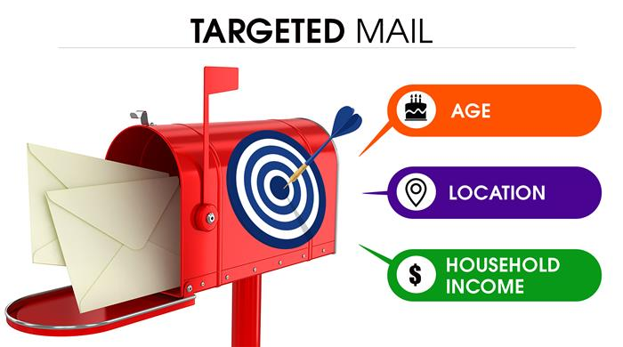
CRM-II: Generate new promotions and sales
Customer databases may be segmented according to a number of factors that make up their profile.
Promotions and products that have been successful with some customers in a group can be offered to other within the same group: known as cross-selling.
Another aspect of CRM is targeted mail-shots to produce better responses (typically only about 5% of mailed or less respond to mail-shot campaigns).

Slide 25
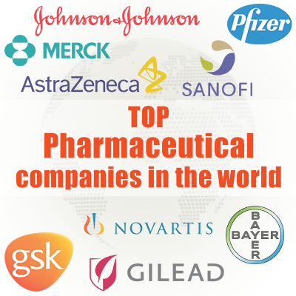
Pharmaceutical companies Example
Target:
Increase the number of prescriptions written for a company’s drugs.
Information Available:
Background information: Specialty of physician.
Statistics collected on the sales per physician of prescription drugs.
Records of sales force’s visits and the number of samples left with physician.
The profiling of physicians could help pharmaceutical companies to direct the efforts of their representatives towards those physicians that are likely to be interested in the company’s products.

Slide 26
E-COMMERCE and Personalized Experience
Customer and transaction data collected on the Internet in increasing amounts.
Personal data and account history easily collected for online shopping as process is automated.
Sequence of steps customer went through may be recorded, enabling the delivery of a personalized shopping experience.
Web mining, or click stream analysis, is the application of data mining to web server logs.
Can help with decisions such as how-to layout site, what adverts to show, etc?

Slide 27
Data Mining in Financial Sector
Credit scoring and risk assessment are common areas of application.
Data mining to predict payment behavior/status.
Fraud/cyber-crime detection
The production of pricing policies based on information supplied during a quote is another frequent application.
The ability to understand knowledge/model is vital.
Visualization tools often used for this type of analysis.
Notes:
One of the first sectors to be involved with data mining, probably because of the high value of the information stored.

Slide 28
Credit card Fraud detection:
Neural networks are the new normal:
https://blog.usejournal.com/credit-card-fraud-detection-by-neural-network-in-keras-4bd81cc9e7fe
https://link.springer.com/chapter/10.1007/978-3-642-39736-3_17
Anti-Money Laundering in Bitcoin:
https://arxiv.org/pdf/1908.02591.pdf

Slide 29
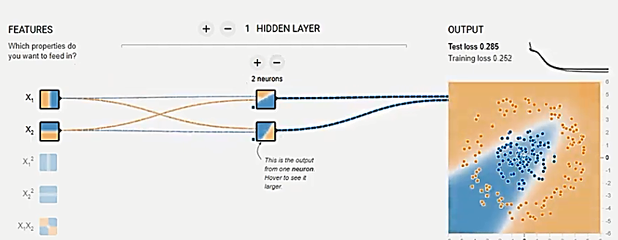
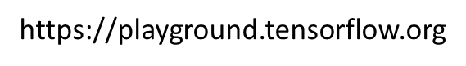
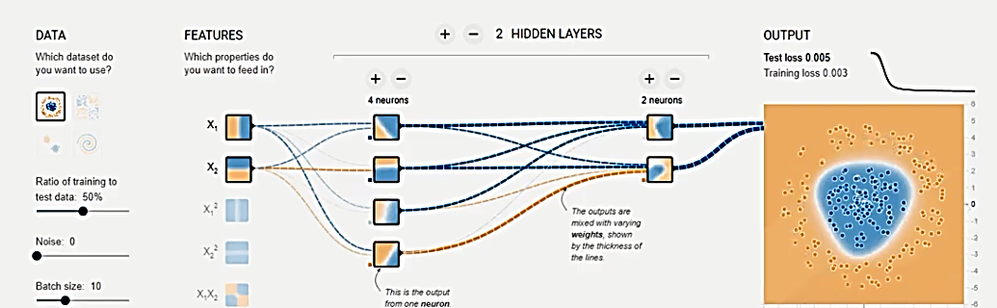
What deep models can do?

Slide 30
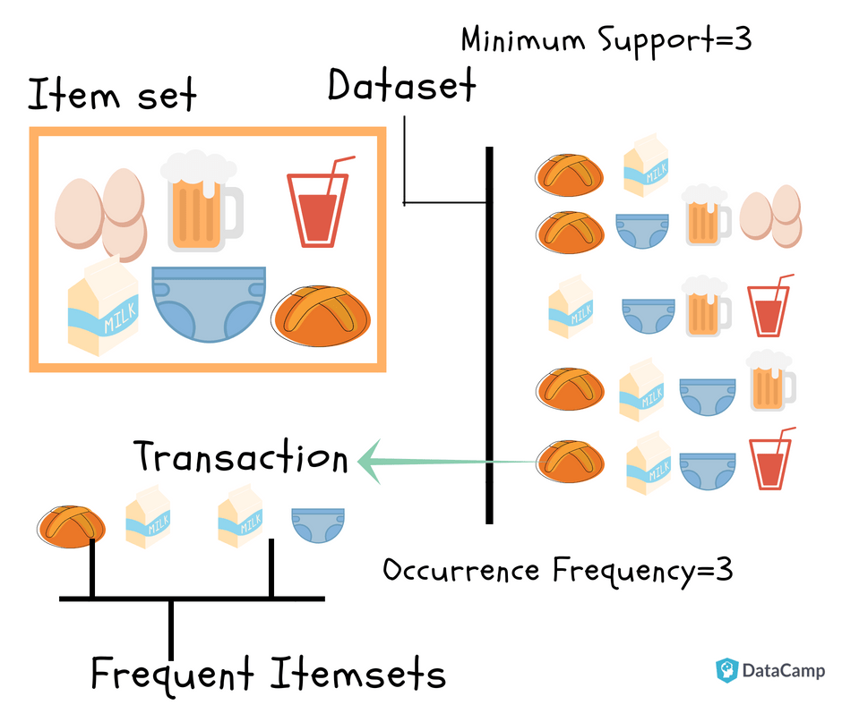
Retail
Market basket analysis is one of the most common activities: finding patterns and associations between products that are purchased together.
Loyalty cards have made market basket analysis very important and effective.
Also, some companies use data mining to investigate most profitable location for new stores.
Some companies have studied the effect of giving free samples to customers.
Notes:
https://learn.uea.ac.uk/bbcswebdav/pid-2777887-dt-content-rid-7183326_1/courses/CMP-7023B-19-SEM2-B/Lecture%208%20_Association_Rules%281%29.pdf

Slide 31
Market Basket Analysis.
Goal is to find rules that may act the starting points for further hypothesis testing.
Techniques used are association rule algorithms.
Many rules produced, not all useful:
On Thursdays, grocery store consumers often purchase diapers and beers together (the useful).
Customers who purchase maintenance agreements are very likely to purchase large appliances (the trivial).
In coronavirus pandemic, one of the most commonly sold items is toilet rolls (the inexplicable).
Market basket analysis provides clear and understandable results.
A weakness is that it requires exponentially more computational effort as the problem size grows, and it discounts rare items.

Slide 32
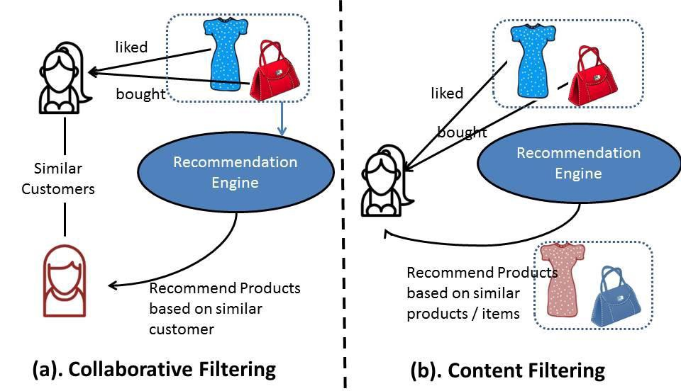
Recommendation Engines

Slide 33
Use Cases in bioinformatics and environmental science

Slide 34
Bioinformatics: Genome Sequencing and Genome wide association studies
Biological data is growing very quickly as thousands of people in the world are decoding parts of the “biological puzzle”, from DNA sequence to protein function and structure, etc, for all types of organisms.
Analysis in this area includes pattern/motif searching, biological image processing, microarray data analysis and the application of data mining to sequence data.
Project at UEA: Data Mining for Emerging Microbial Threats. (http://www.uea.ac.uk/computing/data-mining-for-emerging-microbial-threats)
UK BIOBANK makes infection and health data available to tackle covid-19: https://www.ukbiobank.ac.uk/2020/04/covid/

Slide 35
Scientific data
Observations about phenomenon are collected. Case studies:
satellite/ sky image analysis,
telescope data,
climate research analysis of data collected during earthquakes.
Rate at which data is generated and collected by modern scientific instruments can be as high as gigabytes per hour.
https://www.sciencedaily.com/releases/2019/04/190418145229.htm

Slide 36
Summary
Data mining has many areas of application.
Different application area needs different set of Algorithms based on the tasks.
Techniques are not always straightforward; initial approach may not work best.
Successful applications require familiarity of Knowledge Discovery/ Data Mining process and its steps.

Slide 37
Happy Exploring Data Scientists/ Data Miners!
Thank you for listening!
Questions?
slides@ https://docs.google.com/presentation/d/1WjxOIWnpKkDeD2t3BaLYiaTtJhurfZPcEVHojE9mwIs/edit?usp=sharing
https://drive.google.com/drive/folders/1YuBMH_IqqBeAmG4fu1GYU7ibeGYfQ5AG?usp=sharing

